Slide 1

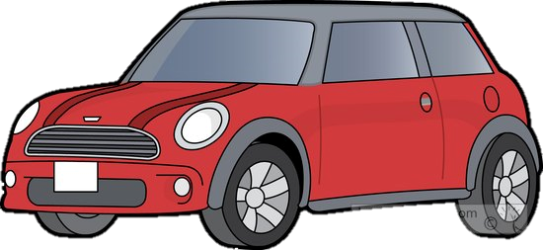
Vehicle Intersection control
Alex Jackson
Jean Lucas Ferreira
Justin Kapinski
Mathew Hobers
Radhika Sharma
Zachary Bazen
Group 6
VIC -1
Intersection Management for autonomous
vehicles

Slide 2
Members
Add pictures of ourselves and the programs were in

Slide 3
The Problem
Requirements were solving

Slide 4
Animation

Slide 5
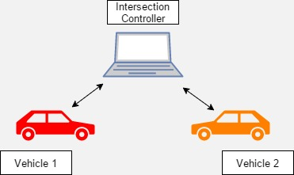
The System - IC and VC
Description of the components and how they interact

Slide 6
Vehicle Controller
Four Main Components
Image processing
Vehicle Navigation
Communication
Hardware Interfacing (servo, speed, ultrasonic sensor)
Notes:
How its working
Parts used

Slide 7
Vehicle Controller (continued)
Lane Following Algorithm
Communication
Data Passing

Slide 8
Video of car driving

Slide 9
Intersection Controller
Why an IC?
Efficient traffic flow
Redundancy/redundant systems
How its working
Parts used
Communication
Camera

Slide 10
Video of IC picking up car going by

Slide 11
Hazard mitigation
IC fails – power generator like in real life
If ic crashes and has power, cars will stop at the intersection
Bluetooth failure, message resent from vehicle

Slide 12
Features Still to be implemented
Bluetooth to other communication
IC vehicle detection
Obstacle detection

Slide 13
THE PROBLEM
How should autonomous vehicles behave when approaching a four-way stop?
single vehicle scenario
multiple vehicles scenario
Notes:
READER: mat
The problem : what to do when more than one vehicle arrives at the intersection at one time
smart intersections to improve efficiency at stop sign intersections
Our Goal ( to increase efficiency of autonomous vehicles at stop sign intersections)

Slide 14
THE SOLUTION
Smart Intersection
Single Vehicle Scenario Solution
Multiple Vehicle Scenario Solution
Decreases time vehicles spend at intersection
Cars save fuel
Cars don’t necessarily have to stop
Two Components:
Intersection Controller
Vehicle Controller
Notes:
READER: Mat
Slide for explaining overall system

Slide 15
INTERSECTION CONTROLLER
What does it do?
Monitors intersection
Manages traffic flow
How does it work?
Vehicle requests to proceed
Controller grants request when appropriate
Notes:
READER: Zach
WHY WE CHOSE TO DO IT THIS WAY
What it does
manages traffic flow
A camera and Computer
chose this approach because the track is shared and we did not want to interfere with other groups, ideally other types of sensors would be used
How it works

Slide 16
1
1
Request
Intersection Controller
3
1
2
Proceed
2
2
3
3
Notes:
READER: Zach

Slide 17
VEHICLE CONTROLLER
What does it do?
Controls motion and direction of vehicle
Ensures vehicle follows lanes and avoids obstacles
How does it work?
Capture track information periodically
Adjust lane positioning
Communicates to the intersection controller when needed
Notes:
READER: JEan

Slide 18
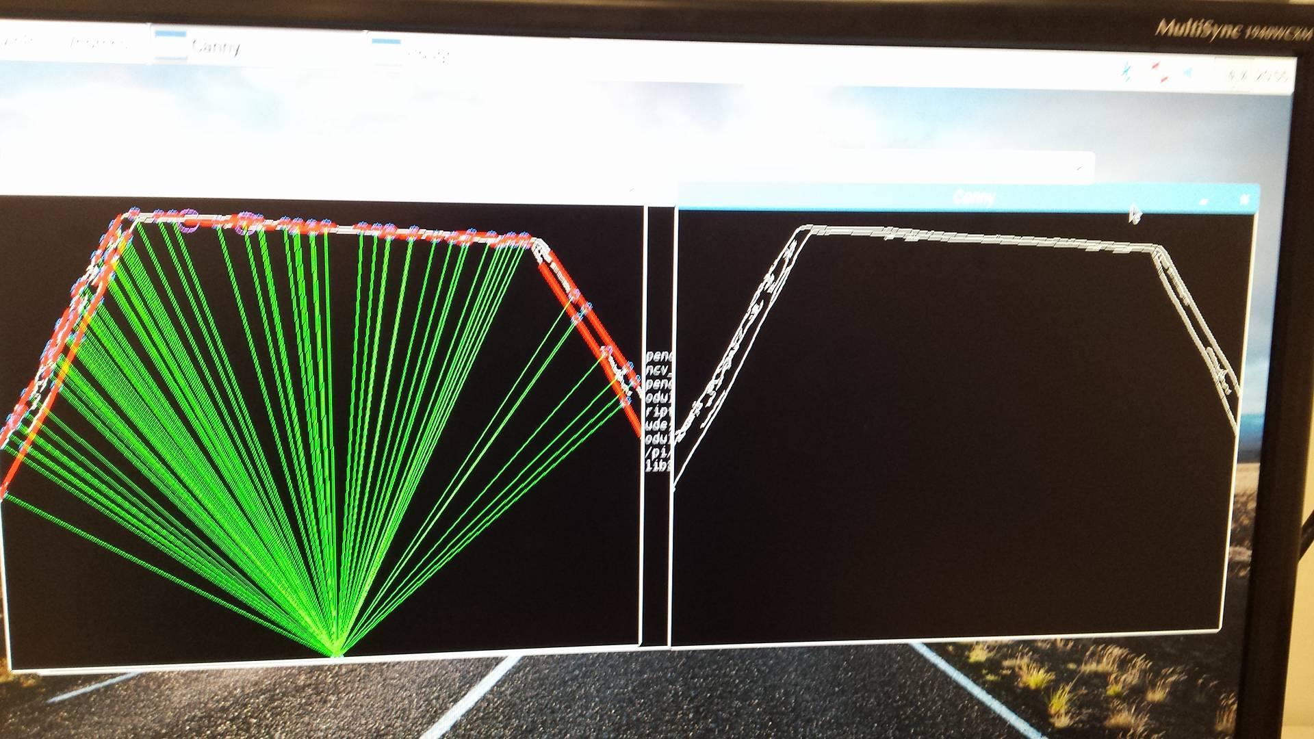
VEHICLE CONTROLLER

Slide 19
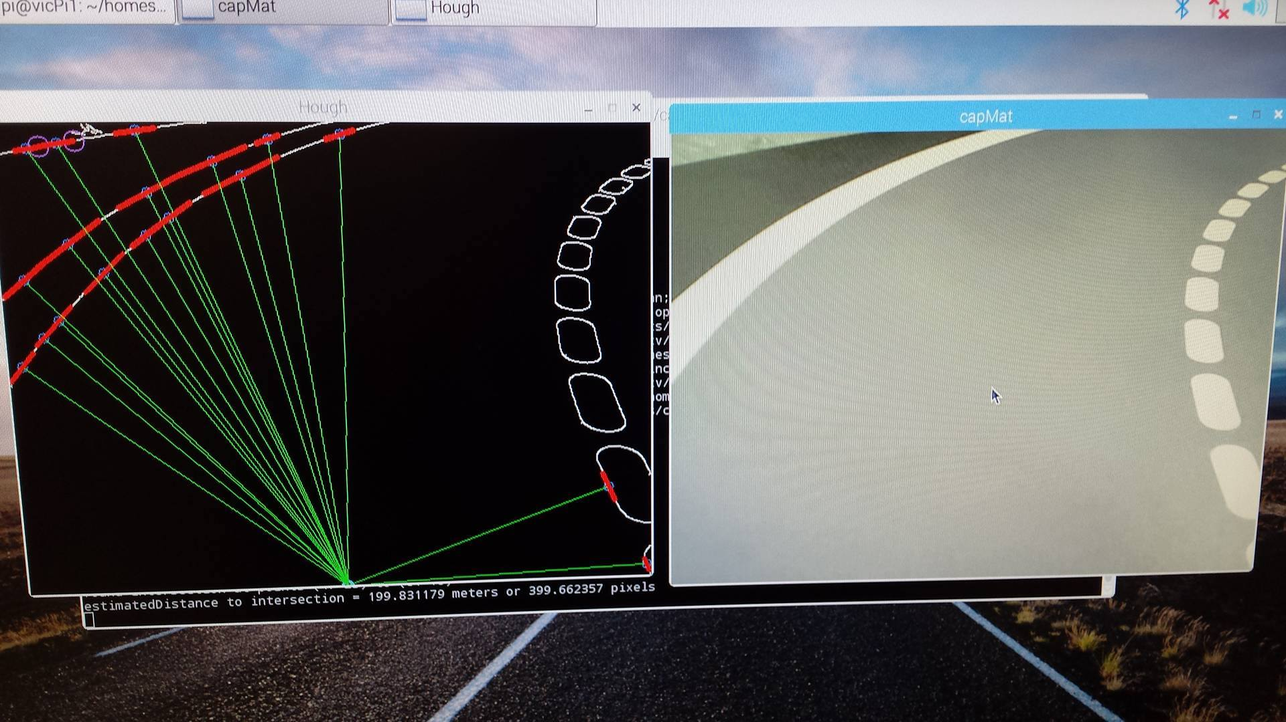
VEHICLE CONTROLLER
Notes:
READER: Jean

Slide 20
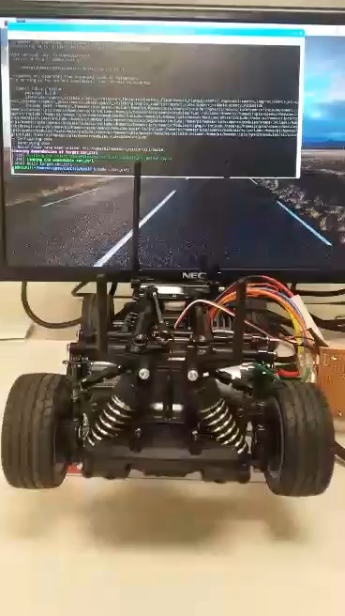

Slide 21
INNOVATIVE ASPECTS
Two Modes
1. Smart Intersection
- Car does not stop at intersection if not needed
2. Normal Intersection
- Car stops at intersection, proceeds when allowed
Intersection Monitoring and Safety
Camera tracks all movement in intersection
Redundancy in object detection
Cars stop and wait at intersection by default
Notes:
Innovative Aspects: Alex
FOR FUTURE USE: (is capable of detecting non autonomous vehicles and pedestrians & Smart Traffic)

Slide 22
COST
PART | QUANTITY | PRICE ($) | TOTAL ($)
RC Car (w/ servo & speed controller) | 2 | 240 | 480
3300 mAh 7.2 V battery | 2 | 30 | 60
Battery charger | 1 | 30 | 30
Raspberry Pi 3 Model B | 2 | 60 | 120
Voltage regulator | 3 | 1.50 | 4.5
Hall Effect sensor | 3 | 1.70 | 5.1
Total: 700
Notes:
Costs: Radhika

Slide 23
TECHNICAL DETAILS
Hardware
Intersection Controller:
Computer with bird-eye view camera
Vehicle Controller:
Raspberry Pi 3
Camera
Hall Effect Sensor
Software
OpenCV (Image Processing)
BlueZ (Bluetooth)
Notes:
READER: Justin

Slide 24
Questions
Group 6
VIC -1

